Slide 1
What is AI?
Powered by AI

Slide 2
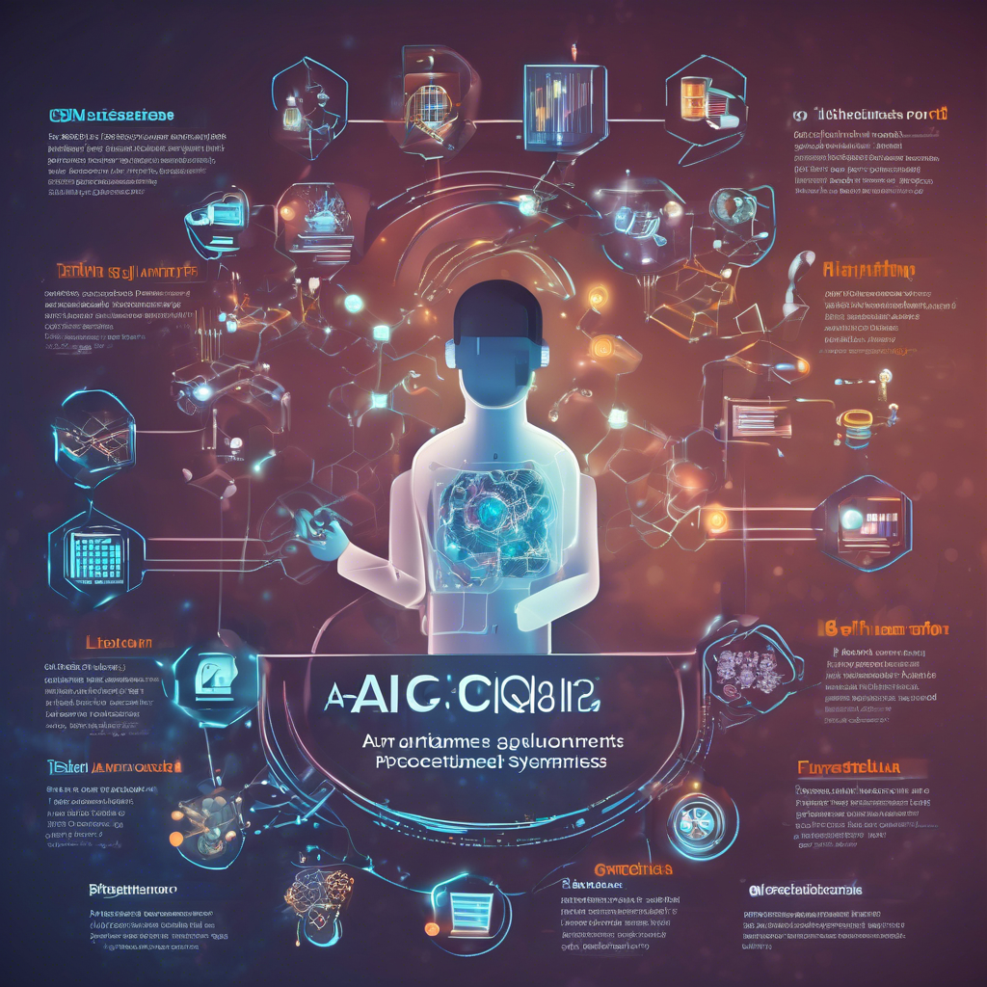
AI's Core Components
Algorithms and data are fundamental. Algorithms process data to learn patterns and make predictions, requiring vast datasets for effective training and refinement.
Computational power and hardware accelerate these processes. Specialized processors like GPUs are crucial for handling the complex calculations inherent in AI systems.

Slide 3
AI Applications Today
- Healthcare: AI aids in diagnosis, drug discovery, and personalized medicine.
- Finance: Fraud detection, algorithmic trading, and risk assessment are improved.
- Transportation: Self-driving cars and optimized traffic management systems.
- Customer service: Chatbots provide 24/7 support and personalized experiences.
- Manufacturing: Predictive maintenance and quality control enhance efficiency.
- Retail: Personalized recommendations and inventory management optimize sales.

